Slide 1
Audience Metrics
Tomás Dodds | Leiden

Slide 2
‘Intellectuals’ shaping public opinion
Early research in print newsrooms showed that journalists typically ignored the opinions of their readers: they dismissed letters to the editors as ‘insane,’ refused to read marketing reports, and relied instead on idealized representations of their audiences.
“[I had] the assumption that journalists, as commercial employees, take the audience directly into account when selecting and producing news … I was surprised to find, however, that they had little knowledge about the actual audience and rejected feedback from it. Although they had a vague image of the audience, they paid little attention to it; instead, they filmed and wrote for their superior and themselves, assuming, as I suggested earlier, that what interested them would interest the audience.” (Gans, 1979, p. 229)
“Instead, journalists relied on abstract conceptions of an audience constructed based on hat they knew about their peers, superiors, and relatives.” (Tandoc & Thomas, 2015)

Slide 3
What are audience metrics?
The accurate tracking of online audience behavior in real-time (Tandoc & Thomas, 2015).
Audience measurement: traditional media –newspapers, radios, and television – have relied on readership surveys, circulation figures, and rating systems to track audience preference (Tandoc & Thomas, 2015).

Slide 4
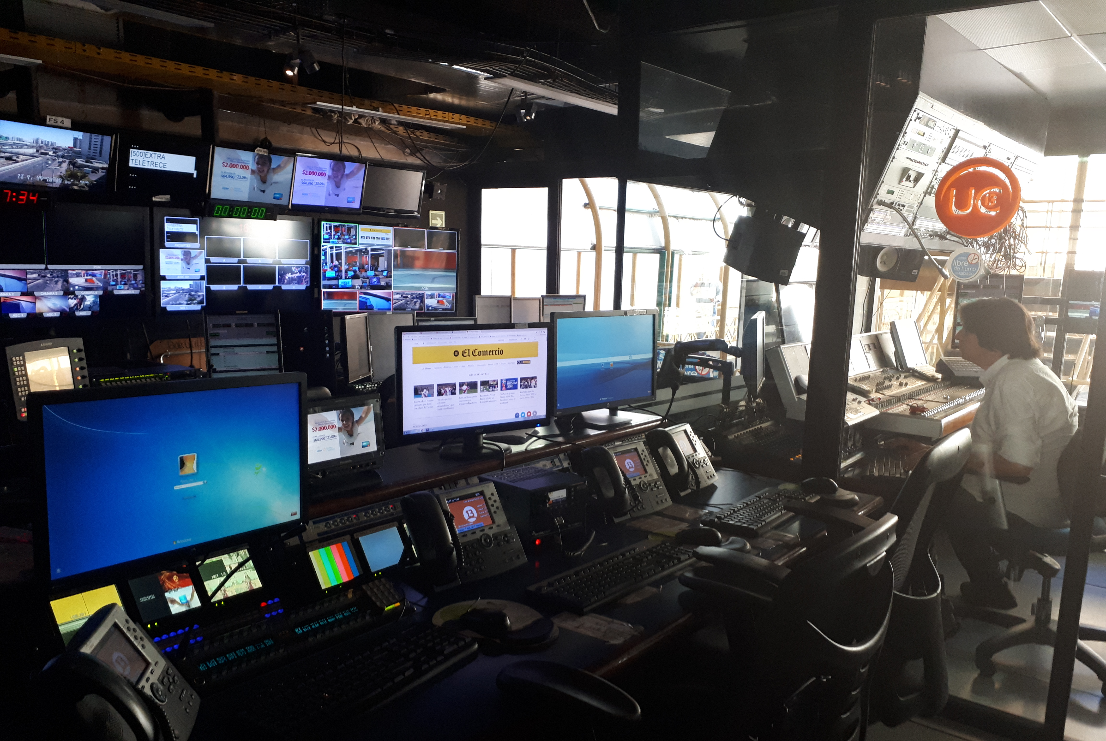
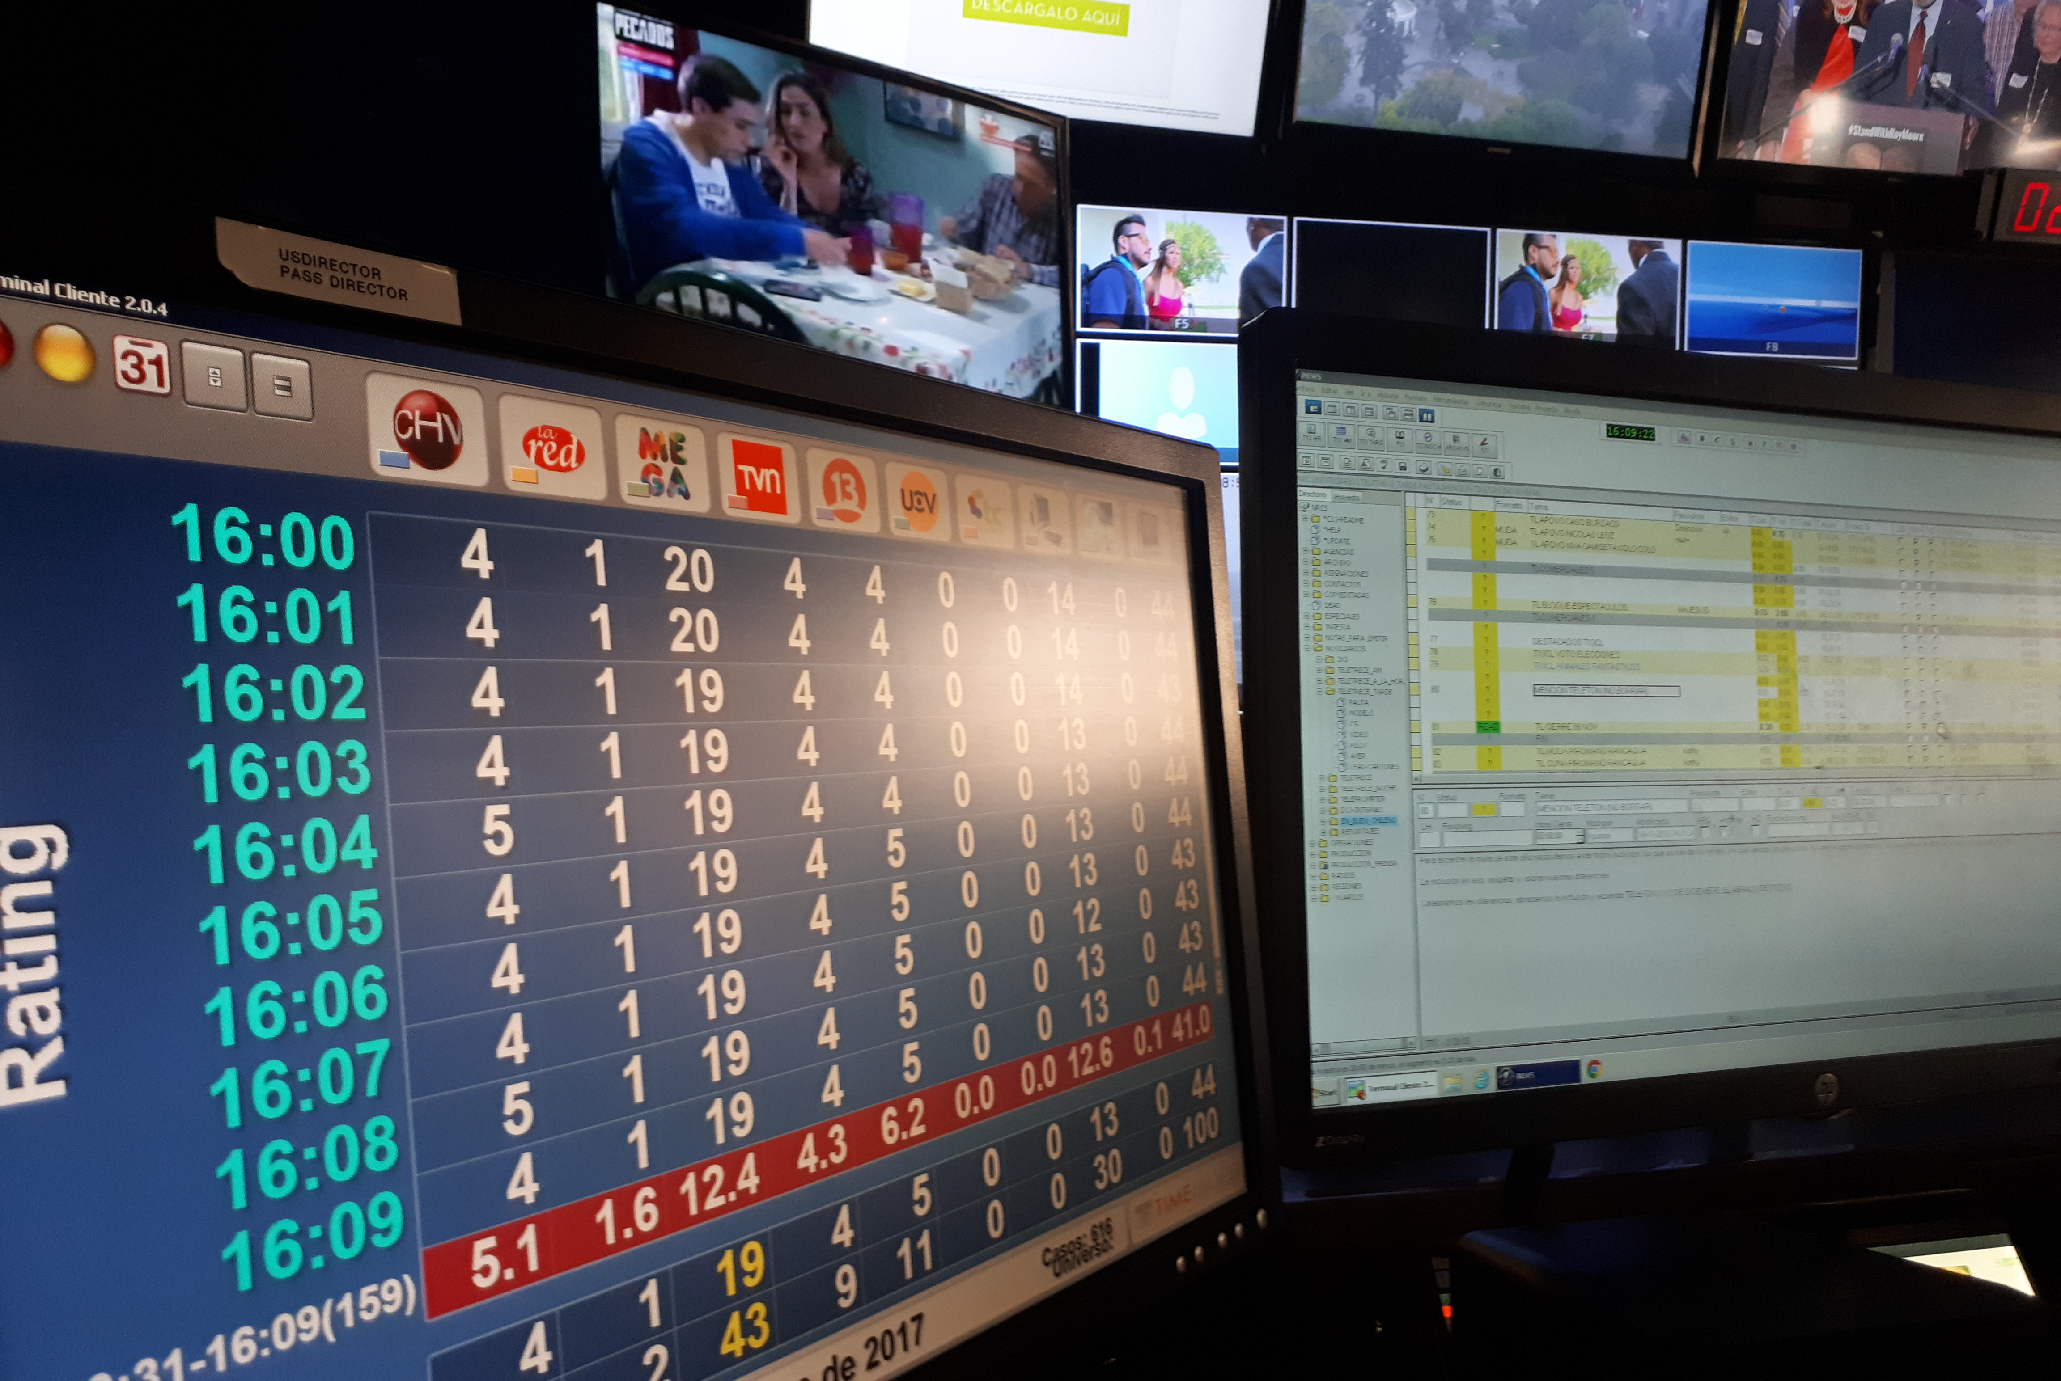

Slide 5
Web analytics: has made audience feedback more visible in the newsrooms so that ignoring the audience is becoming more and more difficult.

Slide 6
Web analytics: has made audience feedback more visible in the newsrooms so that ignoring the audience is becoming more and more difficult.
“this is part of the gradual flattening of the power structure between journalists and their audiences.” (Tandoc & Thomas, 2015)

Slide 7


Slide 8
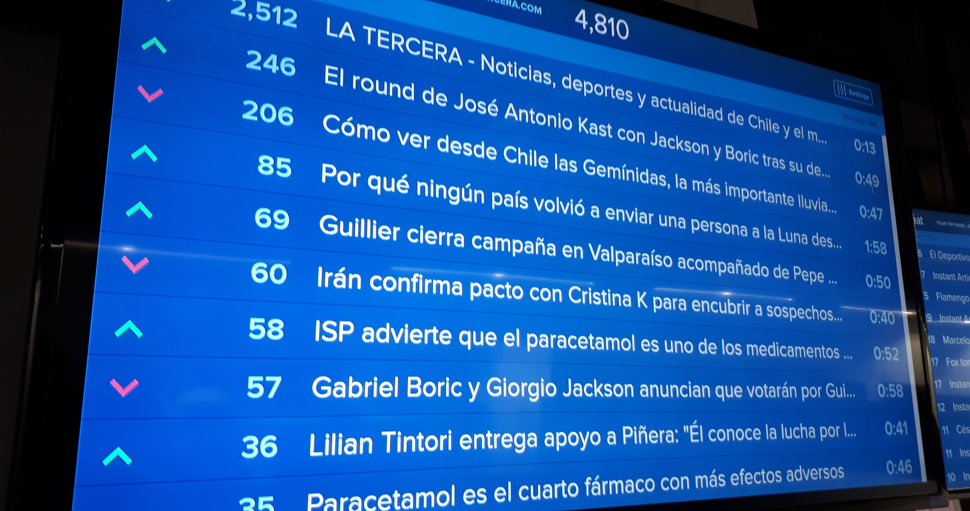

Slide 9
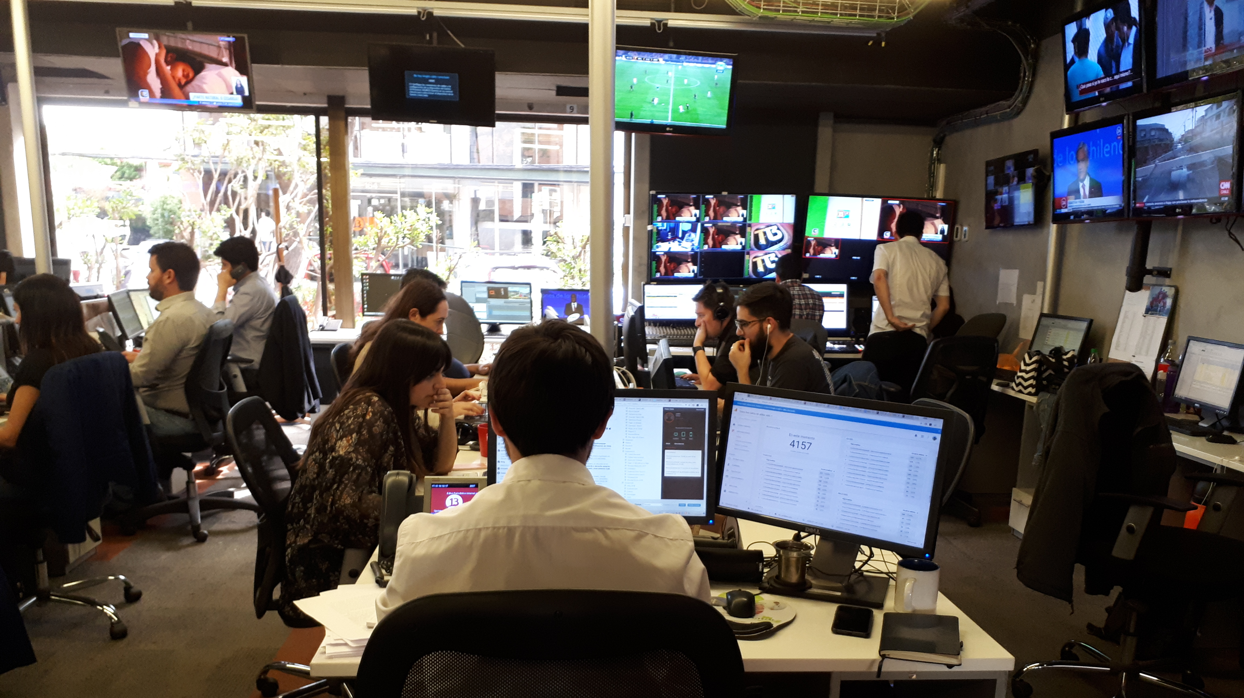

Slide 10
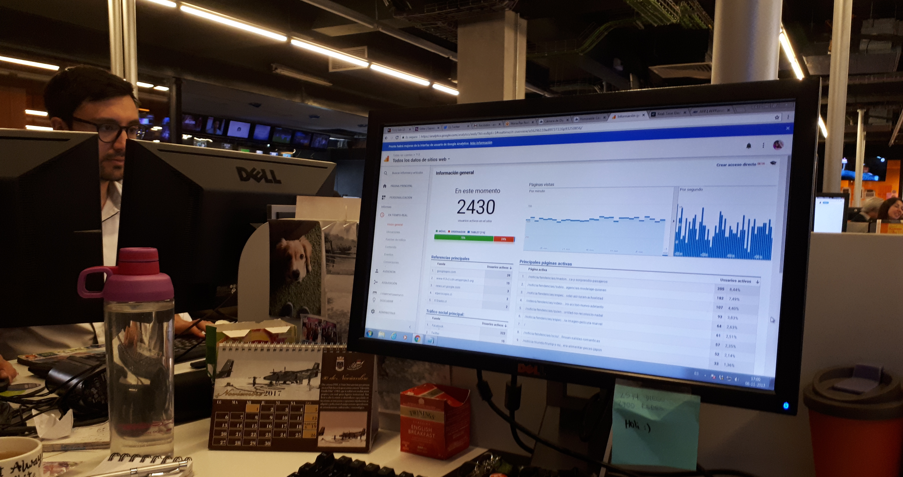

Slide 11
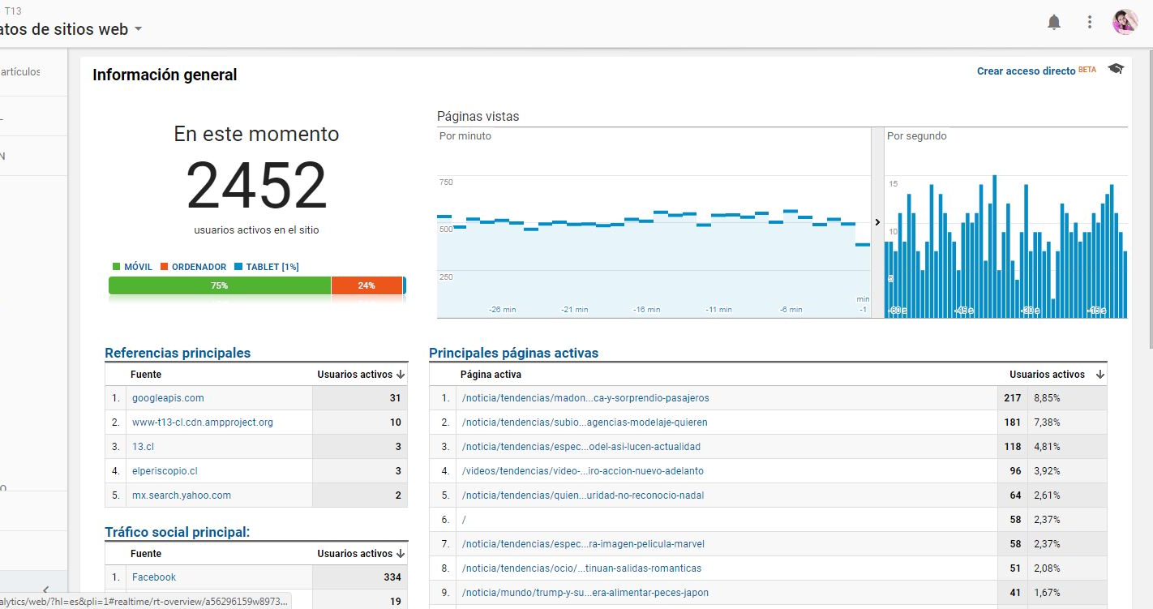

Slide 12
Fine-grained data
It is not only as individual consumers that we are being tracked, quantified, and analyzed; It is also as workers and employees.
Rather than working as a tool to promote inclusion or foster a more diverse exposure for the audience, popularity-driven metrics have arguably become a strongly detailed, low-cost click-counter for the performance of individual news items online
The transformation of qualities into quantities.
Think of clicks, rankings, and stars.
As Christin (2020) put it, ‘What began as tools to track reader behavior and optimize news placement gradually turned into a means to measure workers’ performance: many newsrooms now consider traffic metrics when deciding on hiring, promotions, and layoffs.’
Metrics have what we may call an individualizing focus, contrary to circulation figures for print or ratings for TV.

Slide 13
Algorithmic Publics
Publics that are mediated and represented in web newsrooms through computational software programs.
A concept that encapsulates the influence those perceptions end up having on the development of newsmaking. This, in part, occurs because data analytics are further employed to determine which content gets covered at the end of the day (Zamith Citation2018). According to Tandoc and Thomas (Citation2015, 246), “this is part of the gradual flattening of the power structure between journalists and their audiences.”

Slide 14
Clash between editorial and click-based modes of evaluation
For some, being a web journalist is primarily about maximizing diffusion and promoting one’s content by creating a ‘buzz,’ ‘going viral,’ or ‘trending’ on social media platforms. In this view, the worth of an article depends primarily on its online popularity, which is primarily measured through web analytics.
For others, being a good journalist means writing articles that document something new about the world. Key terms here include original reporting, fact-checking, innovative angles, and earning the respect of fellow journalists.
Often, editorial and click-based modes of evaluation clash.
Professional dissonance.

Slide 15
Opinion power: the ability of the media to influence processes of individual and public opinion formation (Helberger, 2020)

Slide 16
Opinion power: the ability of the media to influence processes of individual and public opinion formation (Helberger, 2020)
“Due to the news media’s gatekeeping and journalists’ editorial decision-making power, where they select the topics and issues for public debate and broader democratic functions, they wield both opinion and political power.”

Slide 17
How are audience metrics impacting this power?

Slide 18
Avoiding a deterministic perspective

Slide 19
Metrics are useful:
They allow editors to compare themselves with rival news organizations
Identify areas of the newsroom that could be underperforming
Increase their advertising revenues
Boost reader’s engagement with news articles

Slide 20
Metrics are dangerous:
Firstly, by making journalists cover topics and issues that they feel go against their ideals of newsworthiness but that they feel will perform well with the audience.
Secondly, by changing decision-making power, from editors inside the newsroom to a complex set of stakeholders

Slide 21
First steps to fix metrics:
Give news organizations control or at least transparency over the input data and parameters upon which metrics are presented.

Slide 22
Audience Metrics
Tomás Dodds | Leiden

